Slide 1
Unlocking Lead Conversion Insights
X Education Lead Conversion Analysis

Slide 2
Driving Sales Growth Through Data-Driven Insights
Business Aspect: Briefly explain the importance of lead conversion for business growth and revenue. Highlight the goal of understanding and improving the conversion rate.
Technical Aspect: State the objective of the analysis – to explore the lead data, identify key factors influencing conversion, and provide actionable recommendations.

Slide 3
Understanding Our Lead Data
9240 leads
columns with null values more than 30% are removed
Filled the null values with their mean or mode respective to their dtype

Slide 4
What Drives Lead Conversion?
Leads originating from 'X' source have a significantly higher conversion rate." (Implication: Invest more in this source.)
"Leads who spend more than 'Y' time on the website are more likely to convert." (Implication: Focus on engaging visitors and improving website content.)
"Specific 'Tags' or 'Last Activity' are strong indicators of conversion." (Implication: Tailor communication based on these signals.)

Slide 5
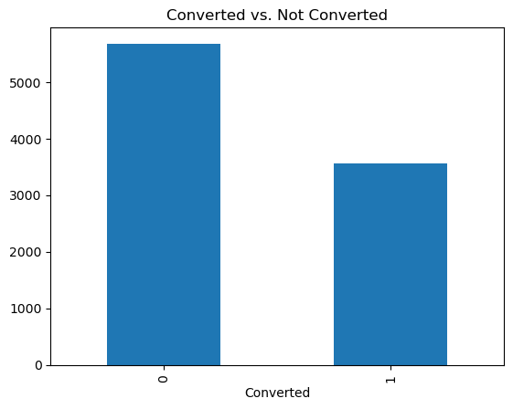
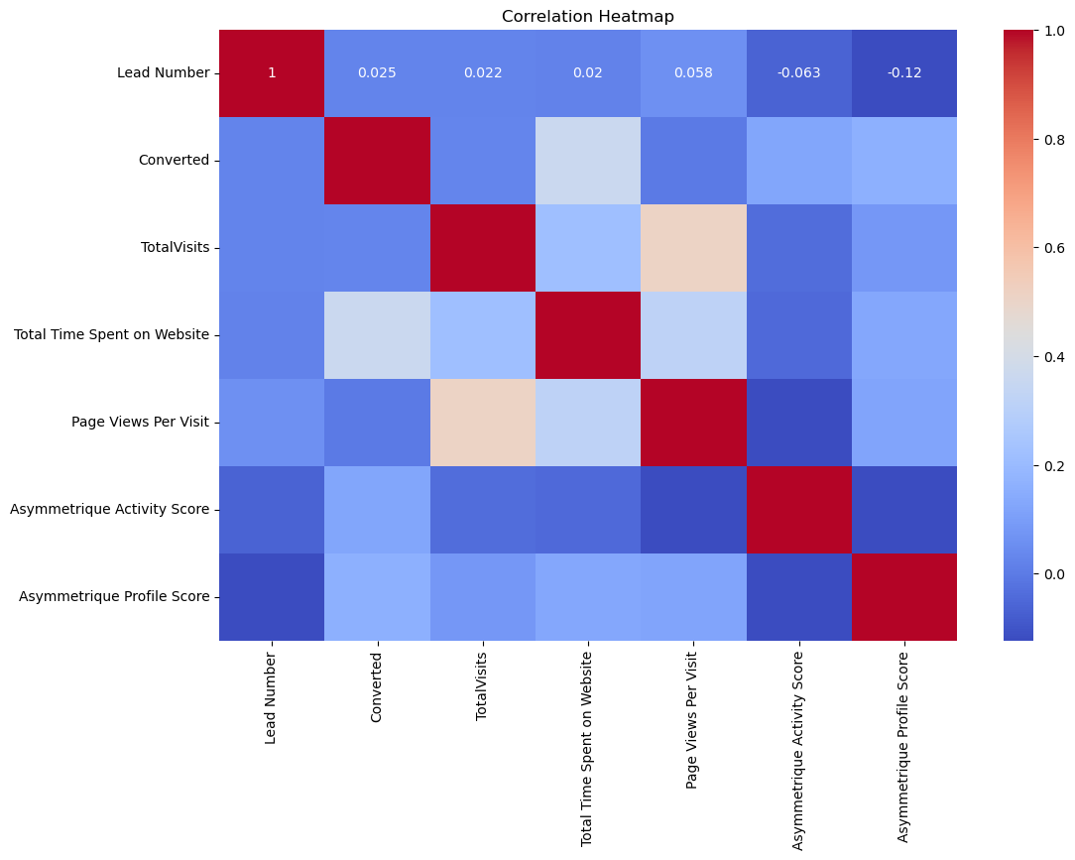
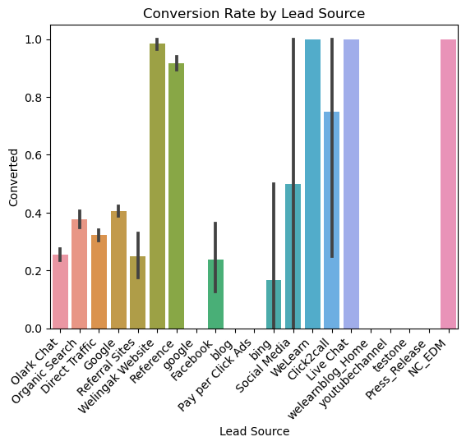
Visualizing Conversion Patterns

Slide 6
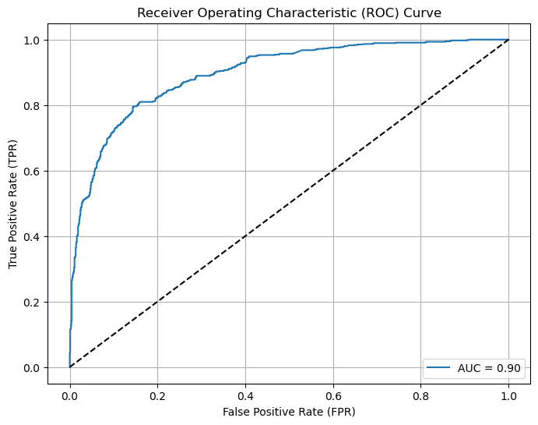
ROC Curve

